Slide 1




- ASIA and OCEANIA
MSc Data Science
(PART I)
TEAM SAAD

Slide 2



TEAM PROFILE
SOHAM PAWAR
ROLE :
ANUDNYA WARE
ROLE :
ATHARVA PATHAK
ROLE :
DARSHAN REDIJ
ROLE :

Slide 3

BIO-DIVERSITY
Biodiversity is a term used to describe the enormous variety of life on Earth. It can be used more specifically to refer to all of the species in one region or ecosystem. Biodiversity refers to every living thing, including plants, bacteria, animals, and humans.
Scientists have estimated that there are around 8.7 million species of plants and animals in existence. However, only around 1.2 million species have been identified and described so far, most of which are insects. This means that millions of other organisms remain a complete mystery. Over generations, all of the species that are currently alive today have evolved unique traits that make them distinct from other species. These differences are what scientists use to tell one species from another.
Organisms that have evolved to be so different from one another that they can no longer reproduce with each other are considered different species. All organisms that can reproduce with each other fall into one species.
Scientists are interested in how much biodiversity there is on a global scale, given that there is still so much biodiversity to discover. They also study how many species exist in single ecosystems, such as a forest, grassland, tundra, or lake. A single grassland can contain a wide range of species, from beetles to snakes to antelopes.
Ecosystems that host the most biodiversity tend to have ideal environmental conditions for plant growth, like the warm and wet climate of tropical regions.

Slide 4

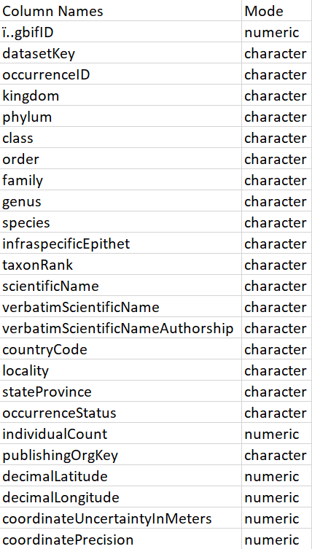
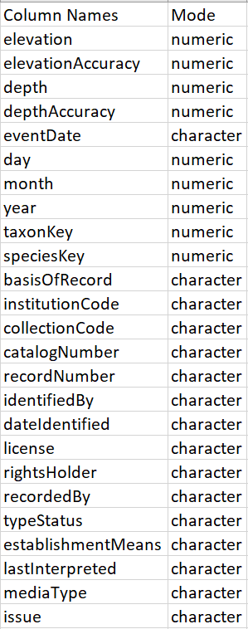
OVERVIEW OF DATA
RAW DATA
EXPLANATION
library(dplyr)
library(Xmisc) #strip functions can be used
library(leaflet) # used for interactive maps
library(dslabs)
library(ggridges)
library(plotly)
library(tidyr)
library(wordcloud2)
library(stringr)
library(naniar)
biodiv_asia_oceania <- read.csv('BIODIVERSITY_ASIA_OCEANIA.csv')
countries_code <- read.csv('countries_codes_and_coordinates.csv')

Slide 5
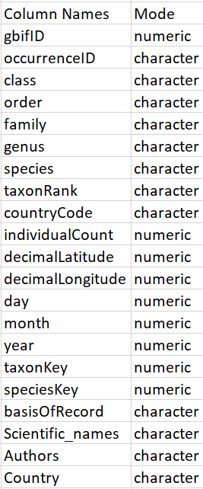
PRE-PROCESSING OF DATA
MAIN DATA
EXPLANATION
Columns which were selected from the raw data were class,order,occurenceId,lat,lng,species,family,countrycode,year,day,month,taxonkey,scienticname, verbatim scientific name, verbatim sci name author. Verbatim scientific name contained scientific names and authors name as a concatenation. So we modified and mutated 2 columns verbatim scientific name and verbatim authorship(author) using string split to get scientific names as a single column. Authors name was also extracted using a similar method. We merged a Countries csv file with the above filtered data using a left join; which consisted of country name, 2 letter country code, and average latitude longitude of each country. There were some blank values in scientific names column so we dropped them. All this data then was stored in single variable main_data for further processing
Library used dplyr.. Data.head()
filtered_biodiv <- biodiv_asia_oceania %>%
select( gbifID = ï..gbifID,occurrenceID, class, order, family, genus, species, taxonRank, scientificName,
verbatimScientificName, verbatimScientificNameAuthorship, countryCode, individualCount,
decimalLatitude, decimalLongitude, day, month, year, taxonKey, speciesKey, basisOfRecord)
filtered_biodiv1 <- filtered_biodiv %>% rowwise() %>%
mutate(Scientific_names =paste0(setdiff(strsplit(as.character(verbatimScientificName),split = " ")[[1]],
strsplit(as.character(verbatimScientificNameAuthorship)," ")[[1]] ),
collapse = ' ') ) %>%
select(-verbatimScientificName,-verbatimScientificNameAuthorship)%>%
rowwise() %>%
mutate(Authors = paste0(setdiff(strsplit(as.character(scientificName),split = " ")[[1]],
strsplit(as.character(Scientific_names)," ")[[1]] ),
collapse = ' ') )%>% select(-scientificName)
countries_code$countryCode <- countries_code$countryCode %>% strip(char = " ")
countries_code$CODE <- countries_code$CODE %>% strip(char = " ")
main_data <- filtered_biodiv1 %>% left_join(countries_code, by= "countryCode")
main_data <- main_data %>% filter(!(Scientific_names==""))

Slide 6
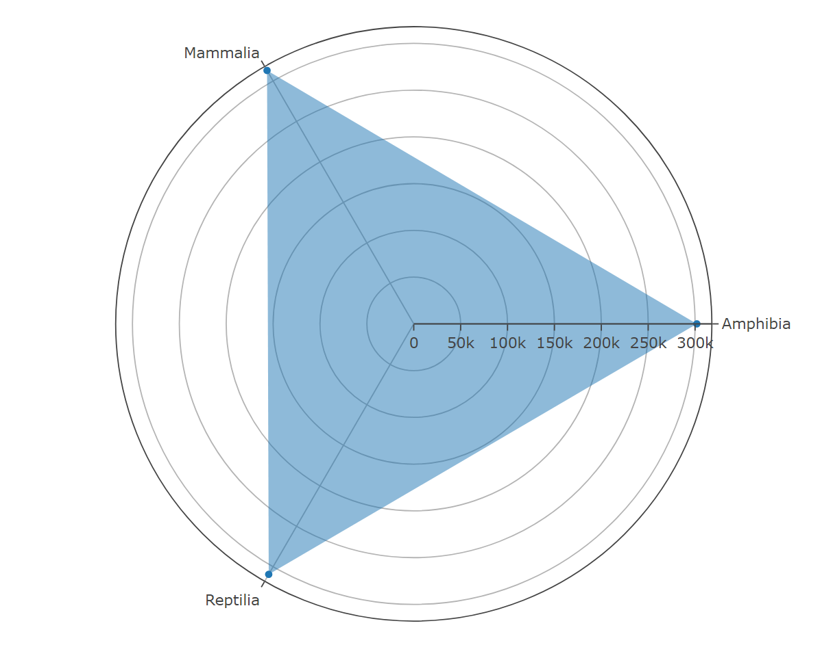
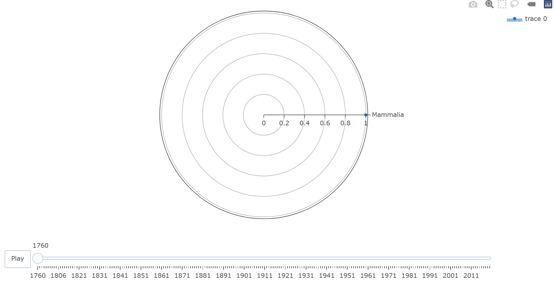
Objective 1 : To check the Total occurrences of each class in ASIA and Oceania.
Processing steps :
Filtering the data in order to remove blank values in class column and summarizing.
Rcodes :
class_occur <- main_data %>% group_by(class) %>%filter(!(class == ""))%>%summarise(Class_count=n())
Visualization Using package Plotly :
plot_ly(
type = 'scatterpolar', # Type = scatterpolar,gives radarchart
r = class_occur$Class_count,
theta = class_occur$class,
fill = 'toself'
)
Here we can see that the total occurrences of Mammalia > Repitilia > Amphibia.
But their count is close enough so we can conclude that all three classes are almost equally populated in Asia and Oceania
If we have to check the occurrences distribution on a yearly scale grouping the data by year and class so that we get a year column for slider.
Rcodes :
class_occur_y <- main_data %>%
group_by(year, class) %>%
filter(!(class == "")&!(year==""))%>%
summarise(Class_count=n())
plot_ly(
type = 'scatterpolar',
r = class_occur_y$Class_count,
theta = class_occur_y$class,
fill = 'toself',
frame = class_occur_y$year
)

Slide 7
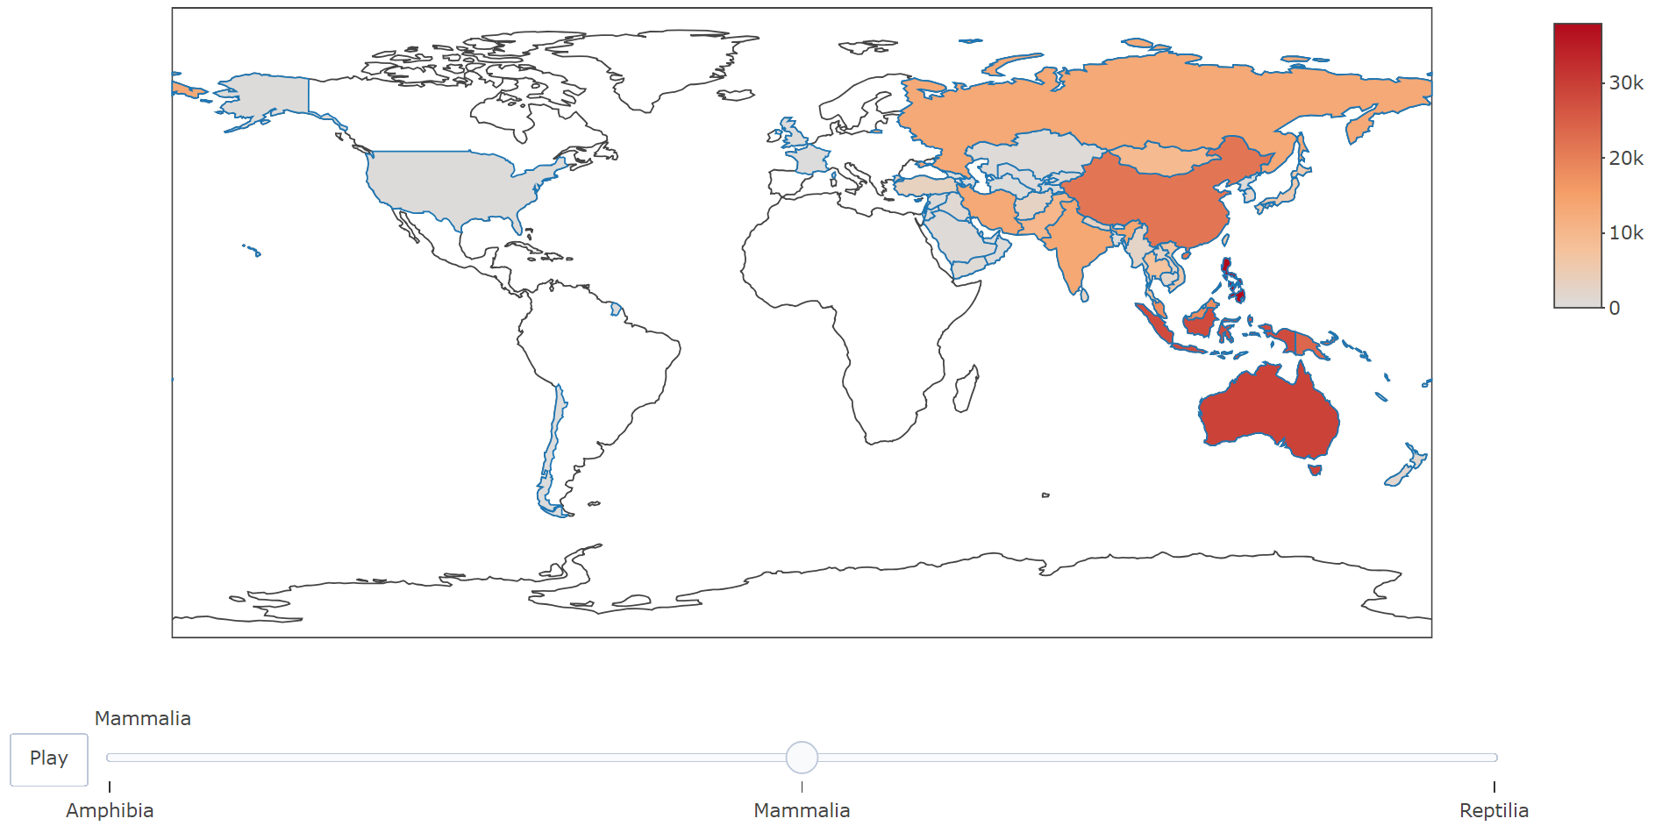
Objective 2 : Plotting Population of each class in different region/country
Processing steps :
Grouping the given columns
Rcodes :
country_class <- main_data %>%
group_by(Country, CODE,
lat= Latitude..average.,
lon= Longitude..average.,class)%>%
summarise(count = n())
Visualization Using package Plotly :
Using a Choropleth map to show how much is the data populated in different regions
Rcodes :
choropleth <-
plot_ly(data = country_class,
type='choropleth',
locations=country_class$CODE,
z=country_class$count, # It gives intensity to the map
text=country_class$Country,
colorscale="Reds",
frame = country_class$class)%>%
layout(g <- list(
scope = 'asia',
showland = TRUE,
landcolor = toRGB("gray95"),
subunitcolor = toRGB("gray85"),
countrycolor = toRGB("gray85"),
countrywidth = 0.5,
subunitwidth = 0.5,
lataxis = list(range=c(min(country_class$lat),max(country_class$lat))),
lonaxis = list(range=c(min(country_class$lon),max(country_class$lon)))
))
choropleth
Conclusion :
The total occurrences for all the three class is the maximum in Philippines.
Class Mammalia is spread across Asia and Oceania but we can see most of the
Amphibians and Reptiles are populated in the countries near oceans or on islands.

Slide 8
Objective 3 : To find some interesting facts about Amphibian fossils.
Processing steps:
Making a copy of the original data.
Replacing blank values with NA with the help of "naniar" library.
Filtering main data so that we get amphibian species fossils.
Rcodes :
main_data_copy = data.frame(main_data)
main_data_copy = main_data_copy %>% replace_with_na(replace = list(Authors = ""))
fossil <- main_data_copy%>%
filter(basisOfRecord=="FOSSIL_SPECIMEN",
class == "Amphibia",
taxonRank == 'SPECIES')
Visualization Using Leaflet :
Mapping the amphibian fossils on the map on the basis of latitude and longitude of where they were found using the leaflet library and esri world imagery map layout for satellite view of the earth map.
Rcodes :
plot <- leaflet()%>% addTiles() %>% addCircleMarkers(data = fossil,
lat = ~decimalLatitude,
lng = ~decimalLongitude,
radius = ~0.5,
color = "#000000",
popup = ~Scientific_names
) %>% addProviderTiles(providers$Esri.WorldImagery)
plot

Slide 9
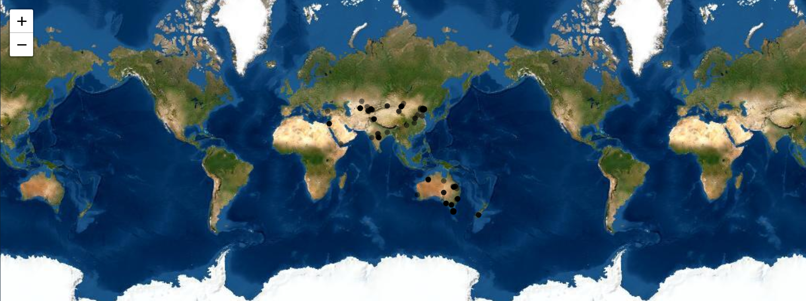
FINDINGS :
We find an interesting plot on the map which is in the middle of the desert upon inspection we find that the plot belongs to a fossil of a frog Kizylkuma Antiqua which is a marine frog that went extinct 90-95 million years ago.
Even more interesting , frogs need water or some sort of moisture to stay alive or else their skin dries out which results in death.
The fossil of the forementioned frog was found in the Kyzylkum Desert of Uzbekistan which is the 15th largest desert in the world.
So in conclusion, for the frog to live there millions of years ago means there is a possibility of some water body near to the frog for it to stay alive that is there was some waterbody where there’s a desert in present time.

Slide 10
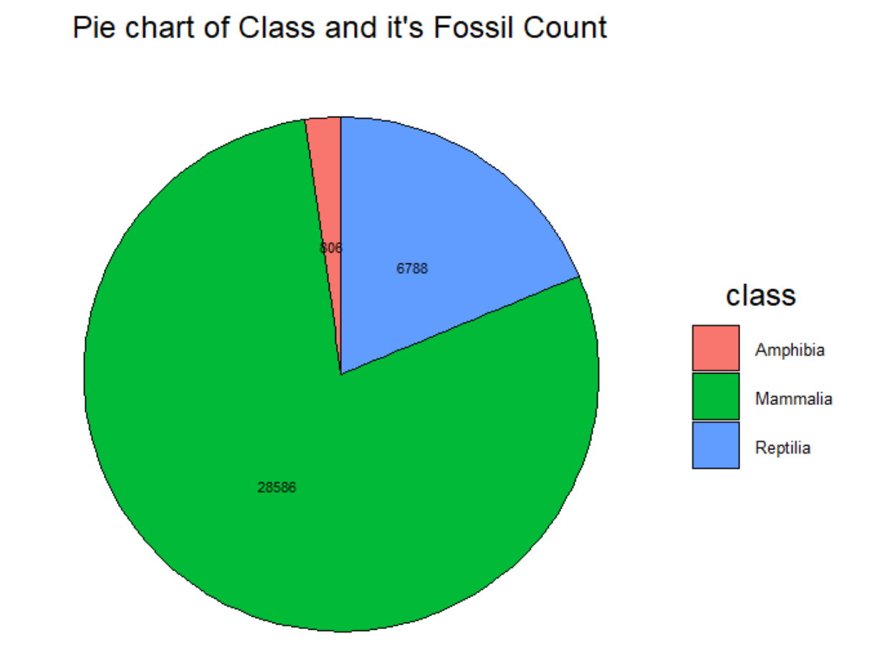
Objective 4 : To find which class has highest number of fossils.
Processing steps:
Replacing blank values with NA with the help of "naniar" library
Removing null values
Calculated the count of Fossils with respect to Class
Arranged the class with maximum number of Fossils
Created a pie chart with ggplot
Rcodes :
main_data_copy_1 = data.frame(main_data)
class_fossil_data = main_data_copy_1 %>% select(class,basisOfRecord)
class_fossil_data = class_fossil_data %>% filter(basisOfRecord=="FOSSIL_SPECIMEN")
class_fossil_data <- class_fossil_data %>% replace_with_na(replace = list(class= ""))
class_fossil_data <- class_fossil_data %>% replace_with_na(replace = list(basisOfRecord = ""))
class_fossil_data <- class_fossil_data %>% drop_na()
Class_Fossil_Record <- class_fossil_data %>% group_by(class, basisOfRecord) %>% mutate(count_total = n())
Distinct_Class_Fossil <- distinct(Class_Fossil_Record)
Distinct_Class_Fossil_Count <- arrange(Distinct_Class_Fossil, desc(count_total))
Visualization :
pie_gg <- ggplot(data = Distinct_Class_Fossil_Count, aes(x="", y = count_total, fill = class)) +
geom_col(color = "black") +
coord_polar("y", start = 0) +
geom_text(aes(label = paste0(count_total)),
position = position_stack(vjust = 0.5), size = 3) +
theme(panel.background = element_blank(),
axis.line = element_blank(),
axis.text = element_blank(),
axis.ticks = element_blank(),
axis.title = element_blank(),
plot.title = element_text(hjust = 0.5, size = 18)) +
ggtitle("Pie chart of Class and it's Fossil Count") +
theme(legend.text = element_text(size = 10),
legend.title = element_text(hjust = 0.5,size = 18),
legend.key.size = unit(1,"cm"))
pie_gg
Conclusion :
Mammalia has highest number of Fossils around 29152.

Slide 11
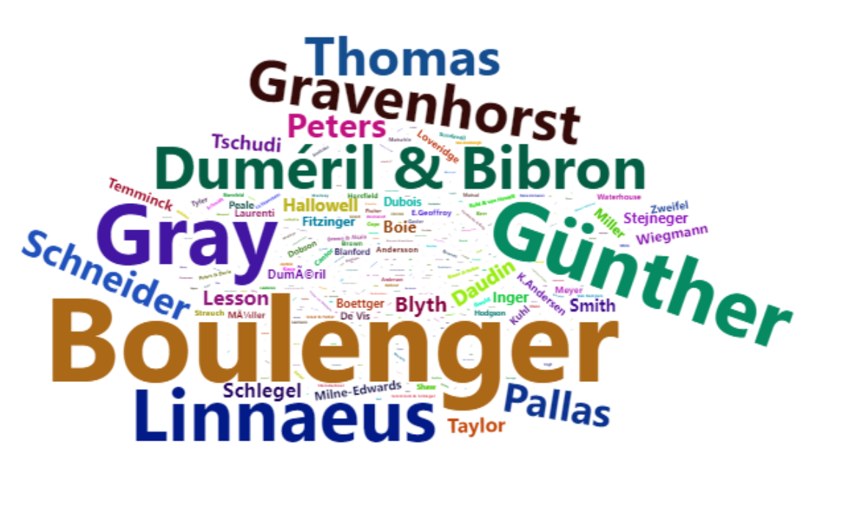
Objective 5 : To find which author got the most citations in the data.
Processing steps:
Upon inspection of the authors column it was found that it had brackets and years associated with the name which are not required for our analysis.
Hence, we remove them using regular expressions.
Upon inspecting the freq_author_name it was found out that some author's name had special characters due to wrong text encoding.
Rcodes :
main_data_copy = main_data_copy %>% mutate(Author_name = gsub("\\(|\\,.*", "", Authors))
authors = main_data_copy %>% select(Author_name) %>% drop_na()
freq_author_name = authors %>% count(Author_name)
freq_author_name$Author_name = str_replace(freq_author_name$Author_name,
"DumÃ©ril & Bibron", "Duméril & Bibron")
freq_author_name$Author_name = str_replace(freq_author_name$Author_name,
"GÃ¼nther", "Günther")
Visualization :
We got the author who has the most citations. Let's make a wordcloud to understand it better
Rcodes :
wordcloud2(data=freq_author_name, size=0.5, color='random-dark', shape = 'pentagon')
Conclusion :
The author with most number of citations is Boulenger. George albert Boulenger FRS (Fellow of Royal Society) who gave scientific names to more than 2,000 new animal species especially fishes

Slide 12
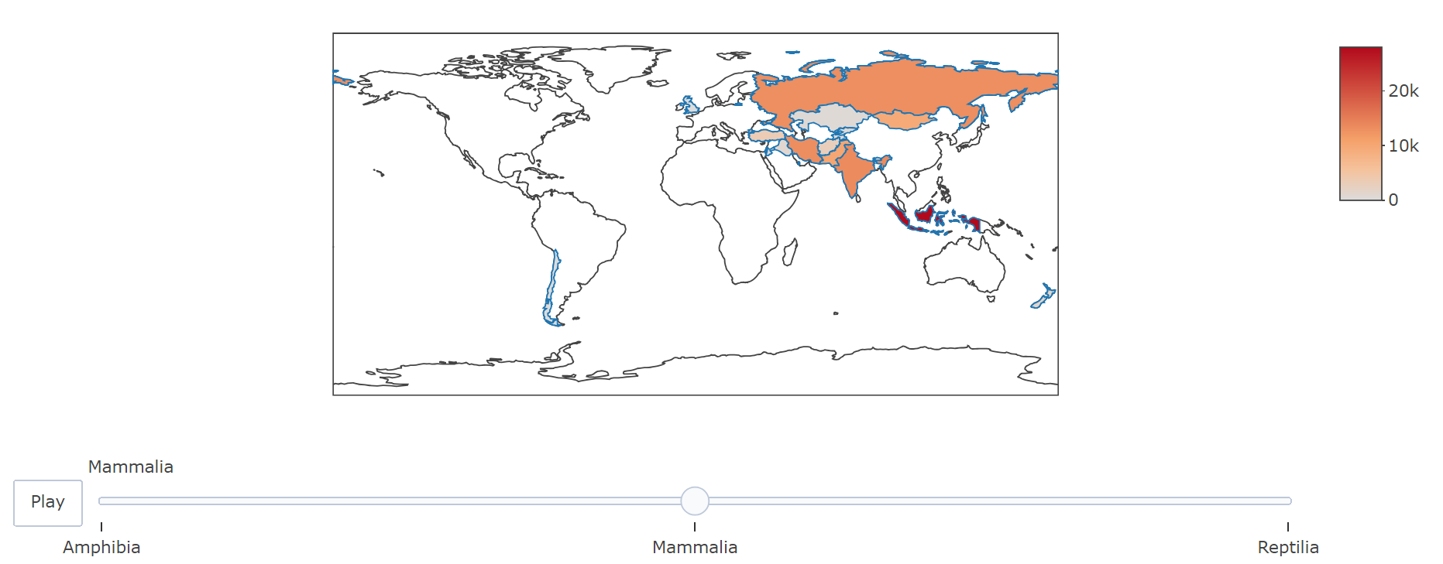
Objective 6 : To understand which class appears most frequently (max(count)) under each Countries.
Processing steps:
Group the main data on Class and Country , arrange the counts in descending order
Each Country is displayed with each class count.
Displaying each country having max(count) of class
Displaying which Class has the maximum count in India.
Rcodes :
max_country_class <-main_data %>% group_by(Country,CODE,class) %>%
summarise( count = n())%>% group_by(class,Country,CODE)%>%
arrange(desc(count))%>%ungroup()%>%
group_by(Country)%>%top_n(1,count)
max_country_class <- max_country_class %>% left_join(countries_code, by = "CODE")
class_india <- m%>% filter(Country == "India")
Visualization :
max_choropleth <-
plot_ly(data = max_country_class,
type='choropleth',
locations= max_country_class$CODE,
z=max_country_class$count, # it gives intensity to the map
text= max_country_class$Country,
colorscale="Reds",
frame = max_country_class$class)%>%
layout(g <- list(
scope = 'asia',
showland = TRUE,
landcolor = toRGB("gray95"),
subunitcolor = toRGB("gray85"),
countrycolor = toRGB("gray85"),
countrywidth = 0.5,
subunitwidth = 0.5,
lataxis = list(range=c(min(country_class$lat),max(country_class$lat))),
lonaxis = list(range=c(min(country_class$lon),max(country_class$lon)))
))
max_choropleth
Conclusion :
India has the maximum count of Mammalia.

Slide 13
Objective 6 : .
Objective 7 : To plot only the max(order) found in India.
Processing steps:
Droping NA from year and 0.00 values from latitude , unselect gbifID, occurenceID columns
Takonkeys(Primary keys) may be repeated several times but the place where it is found is different hence we don't remove the duplicate.
Filtering Rodentia order.
Find the exact Order having maximum count in India
Plot using leaflet(addTiles,addMarkers)
Rcodes :
india <- main_data%>% select(!gbifID)%>%filter(Country == "India",!(decimalLatitude ==0.00),!is.na(year),!(order ==""))
a <- india%>%group_by(order) %>% summarise(count_order = n())%>% arrange(desc(count_order))%>% top_n(count_order, n=1)
rodentia_india <- india %>% filter(order == "Rodentia", !(family == ""))
Visualization Using Leaflet :
plot <- leaflet() %>%
addTiles() %>%
addMarkers(lng = rodentia_india$decimalLongitude, lat = rodentia_india$decimalLatitude,
popup = paste("Family", rodentia_india$family, "<br>","Year:", rodentia_india$year,"<br>",
"Basis of record :",rodentia_india$basisOfRecord,"<br>",
"Scientic name :",rodentia_india$Scientific_names,"<br>",
"Author :", rodentia_india$Authors))
plot

Slide 14
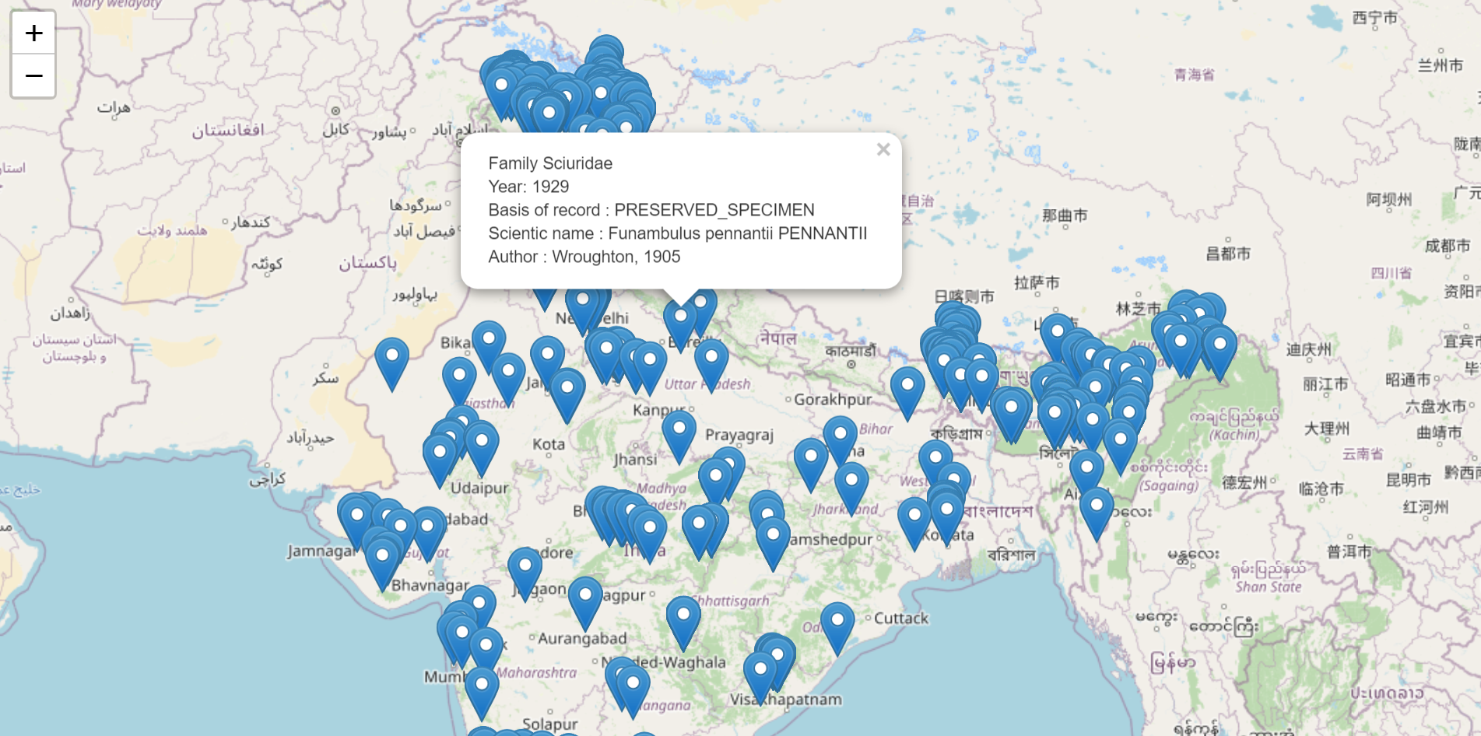

Slide 15
Objective 8 : To Find which order of class decreases throughout the centuries.
Processing steps:
Divide the main data century-wise (1700-1899) and (1900-2020)
Separate 3 classes from the filtered data.
From each class group all the orders and take the count.
Removing all the NA's or blank values from the class data
Merging the values and Comparing the count.
Divide each class by order and count the number of each class
By taking the min of all the counts, go to the class data n filter for only by min(order)
Rcodes :
# divide 1700 till 1900
yearly <- main_data %>% filter( (year >=1700) & (year <1900))
class_amp <- yearly %>% filter(class =="Amphibia")
class_mam <- yearly %>% filter(class =="Mammalia")
class_rep <- yearly %>% filter(class =="Reptilia")
order_amp <- class_amp %>% group_by(order) %>% summarise(count_order = n())
order_amp <- order_amp[-1,]
order_amp <- order_amp %>% arrange(count_order, desc = FALSE)
order_mam <- class_mam %>% group_by(order) %>% summarise(count_order = n())
order_mam <- order_mam[-1,]
order_mam <- order_mam%>% arrange(count_order, desc = FALSE)
order_rep <- class_rep %>% group_by(order) %>% summarise(count_order = n())
order_rep <- order_rep[-1,]
order_rep <- order_rep %>% arrange(count_order, desc = FALSE)
# Dividing year right after 1900
yearly2 <- main_data %>% filter( year >=1900)
class_amp2 <- yearly2 %>% filter(class =="Amphibia")
class_mam2 <- yearly2 %>% filter(class =="Mammalia")
class_rep2 <- yearly2 %>% filter(class =="Reptilia")
order_amp2 <- class_amp2 %>% group_by(order) %>% summarise(count_order = n())
order_amp2 <- order_amp2[-1,]
order_amp2 <- order_amp2 %>% arrange(count_order, desc = FALSE)
order_mam2 <- class_mam2 %>% group_by(order) %>% summarise(count_order = n())
order_mam2 <- order_mam2[-1,]
order_mam2 <- order_mam2%>% arrange(count_order, desc = FALSE)
order_rep2 <- class_rep2 %>% group_by(order) %>% summarise(count_order = n())
order_rep2 <- order_rep2[-1,]
order_rep2 <- order_rep2 %>% arrange(count_order, desc = FALSE)

Slide 16
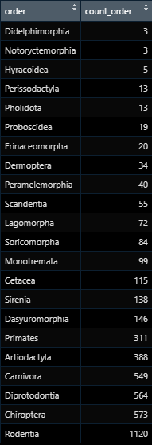
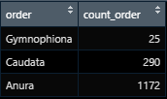
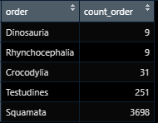
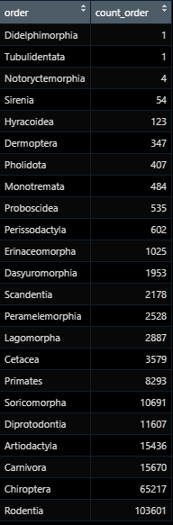
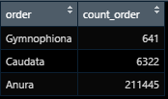
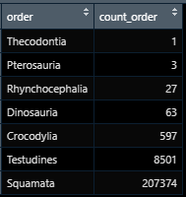
Table Visual:
1700-1899
1900 and above
Order mam
Order amp
Order rep
Order mam
Order amp
Order rep

Slide 17
Conclusion :
Order Didelphimorphia and Order Sirenia of Class Mammalia are slowly on the verge of extinction in the region of Asia and Oceania.
Sirenian populations are easily depleted by activities of people, often falling victim to hunting, drowning in nets, collisions with boats, and habitat degradation.
They are protected by law and international agreements in almost all countries, but in many areas populations remain very low or are extirpated as a result of past and present human activities.
In order Didelphimorphia Gracilinanus aceramarcae, Marmosa andersoni, and Marmosops handleyi are considered Critically Endangered by the IUCN.
Although none of these species face direct threats from humans, all are facing rampant habitat destruction that has strong negative conservation implications.
Other species are facing conservation threats, especially those with restricted distributions and found in habitats affected by high rates of deforestation, but much more information is necessary to correctly assess their status.

Slide 18

ANY QUESTIONS ?
THANKYOU

